Slide 1

Exploratory Data Analysis
<Project name>
<Date>

Slide 2

Agenda
Executive Summary
Problem Statement
Approach
EDA
EDA Summary
Recommendations

Slide 3
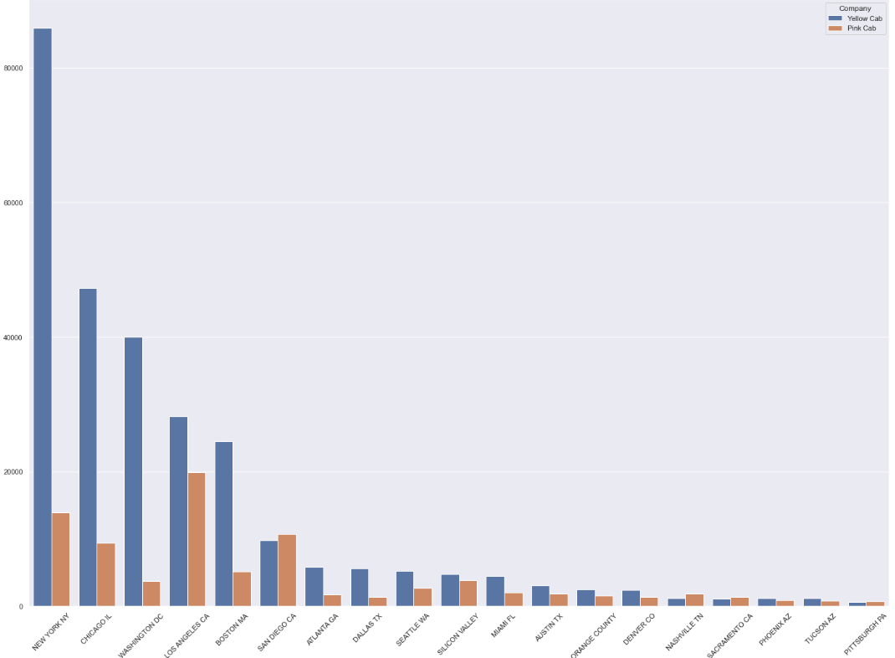
Executive Summary
From this plot we could see that Yellow cab company performs much better than Pink cab company

Slide 4
Hypothesis List
1. Do young people (< 40 year-old) take more cab?
2. Do big cities like New York and LA have more customers?
3. What's the most common payment by each company and how much are they
4. Will the cost per km be more higher in big cities?
5. Is there any seasonality effect in the number of people using cab?
6. Number of users for each company in each city

Slide 5
Data Analysis Approach
Fork project from the provided github, and clone it to local machine
Using Jupyter Notebook to import necessary packages and load data
Perform basic analysis such as dataset’s shape, first and last few rows, features, statistical information of each feature such as mean, std, min etc.
Used box plot to check for outliers and used heatmap to check features’ correlation
Merge datasets by their corresponding features
Provided hypothesis and used visualization to prove/disapprove them

Slide 6
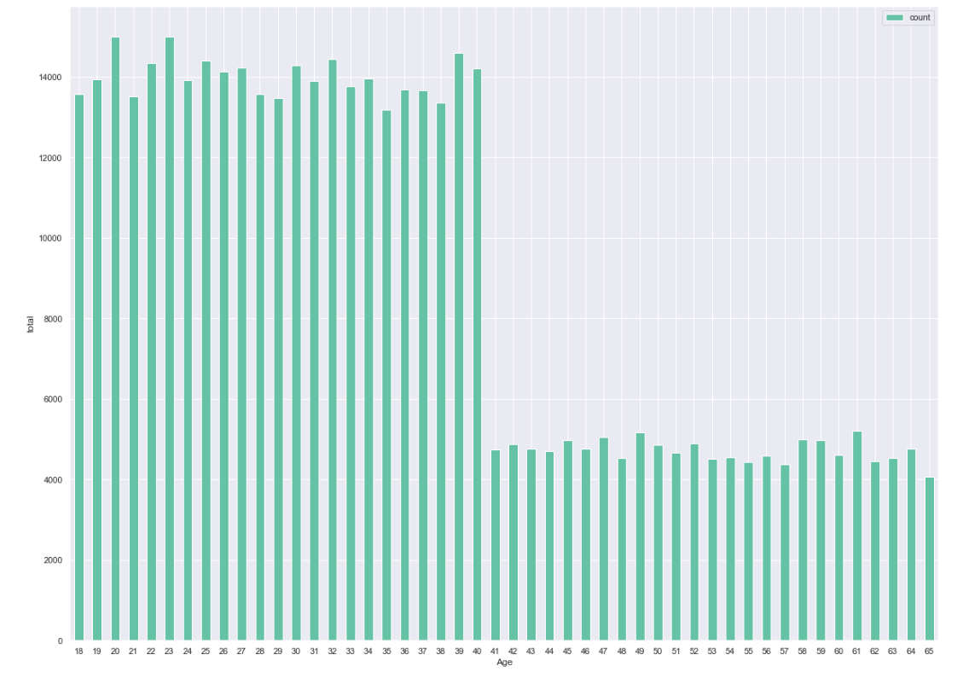
Age analysis

Slide 7
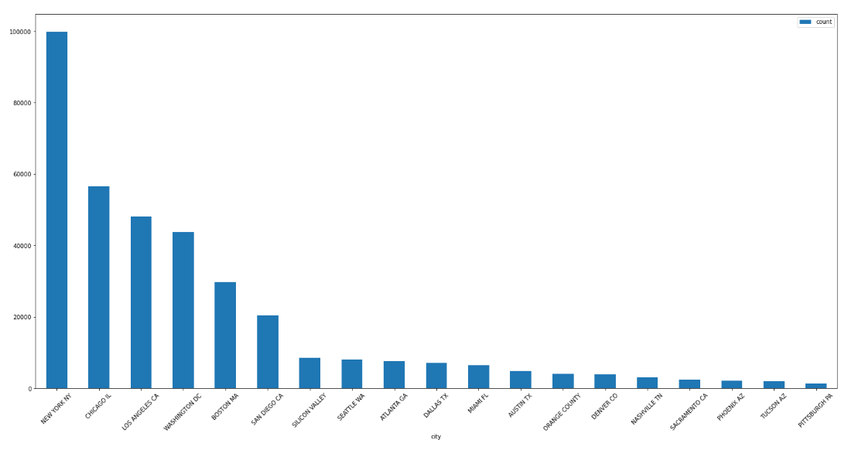
Number of customer in each city

Slide 8
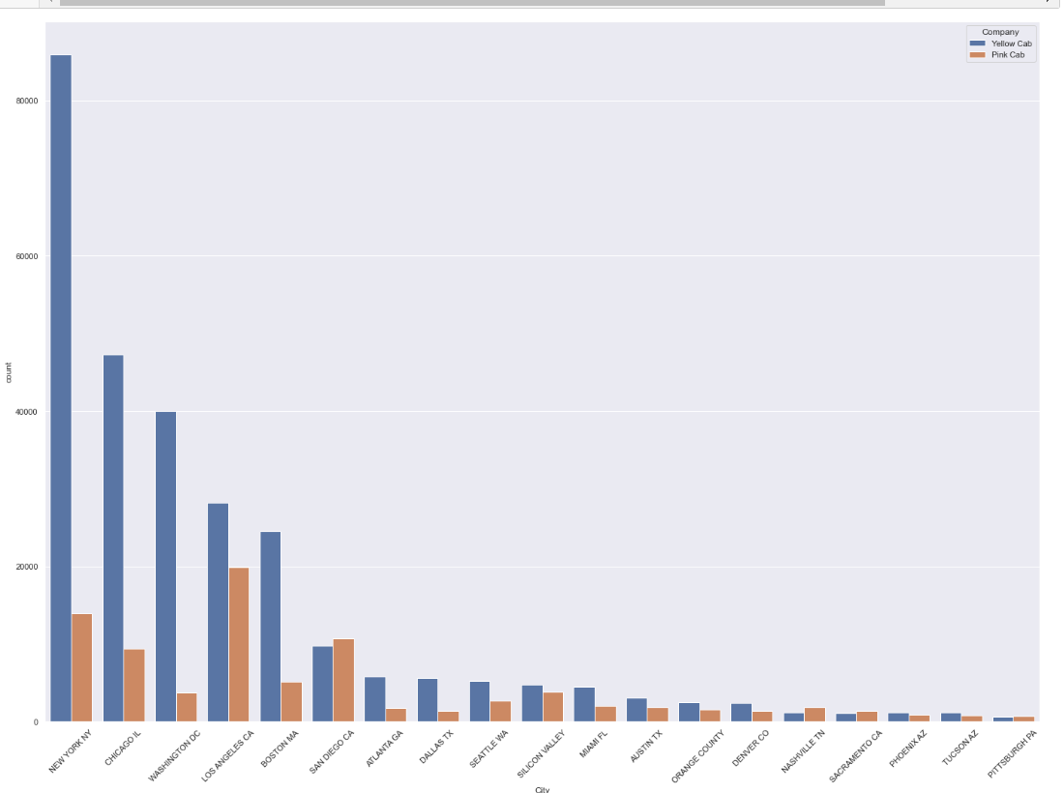
Customer in each city and company

Slide 9
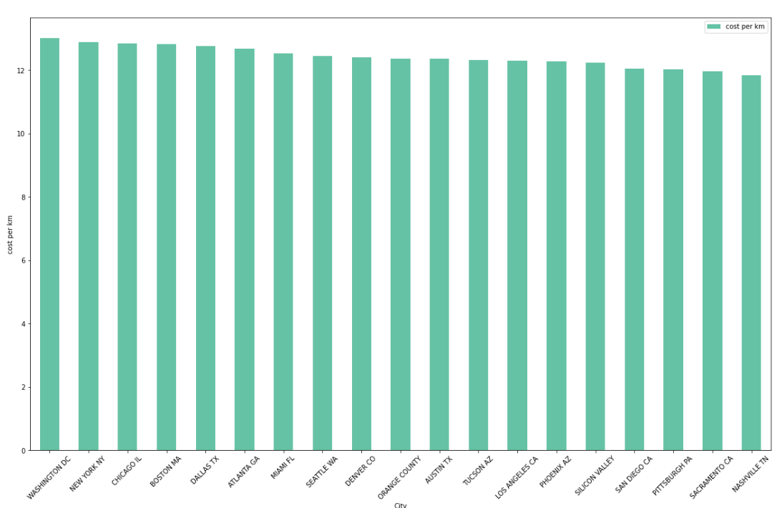
Fuel cost analysis

Slide 10
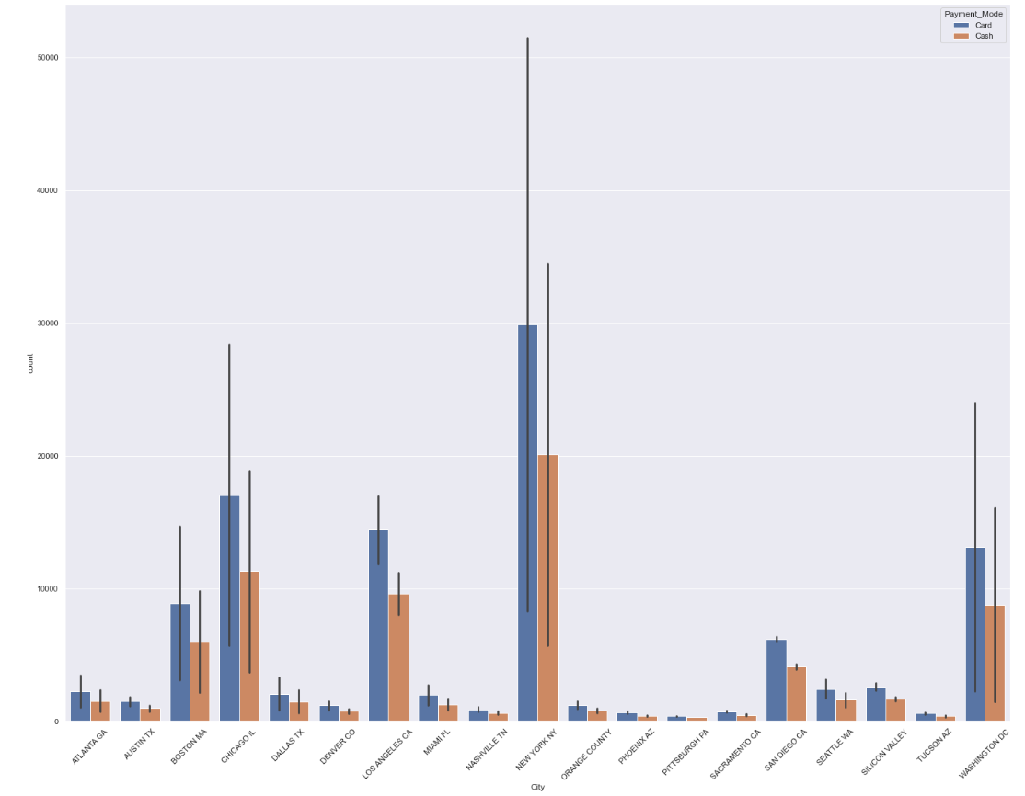
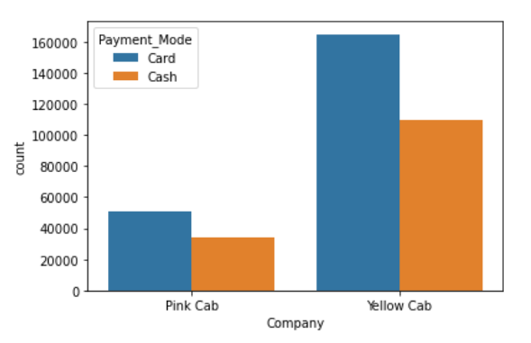
Payment Method analysis

Slide 11
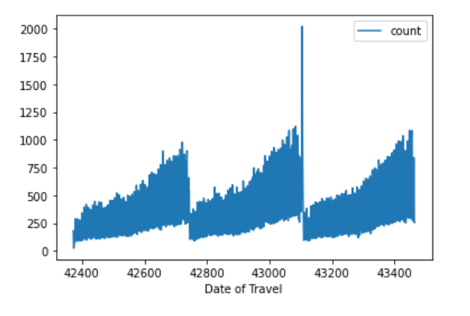
Seasonal effect analysis

Slide 12
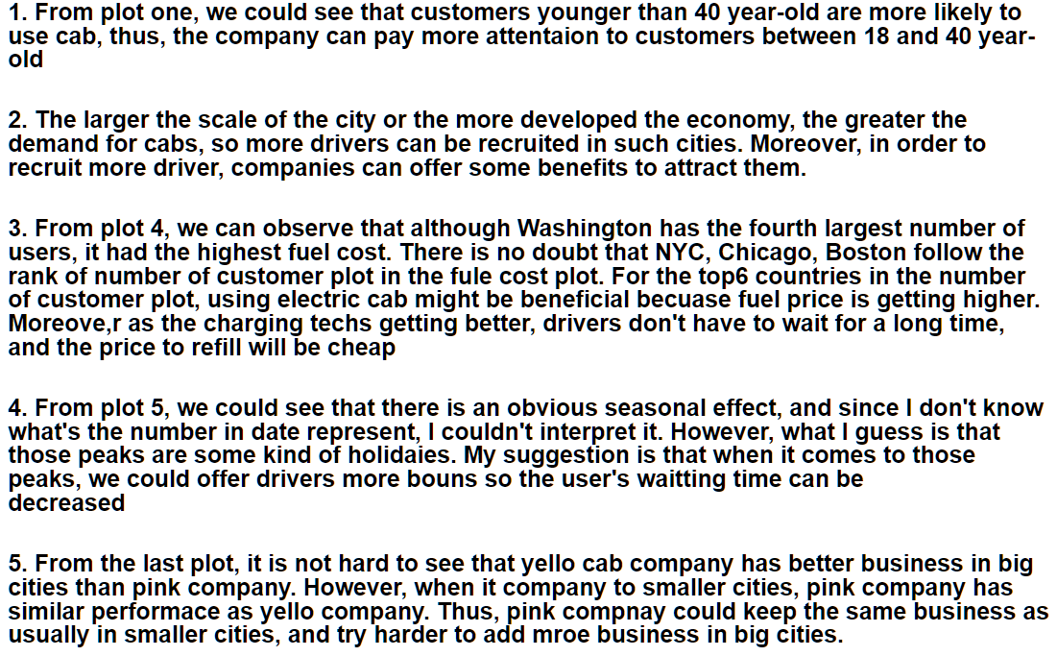
Business Recommendation

Slide 13
Thank You

